Slide 1



PetClicks
Presented by Team OneZero

Slide 2
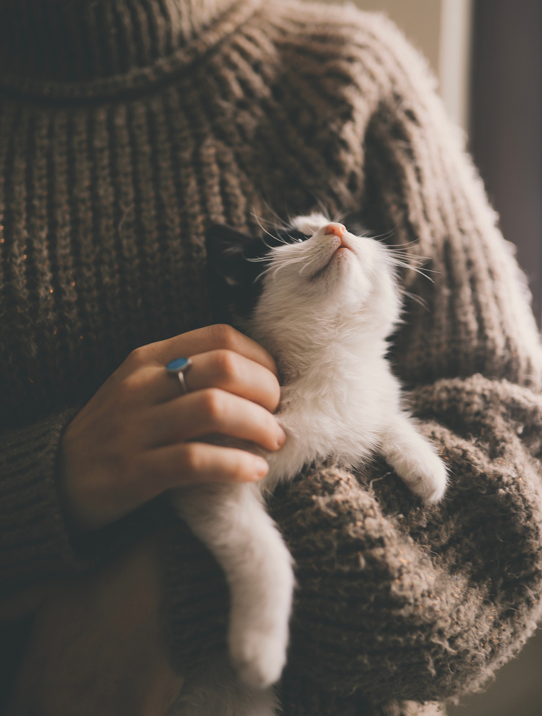
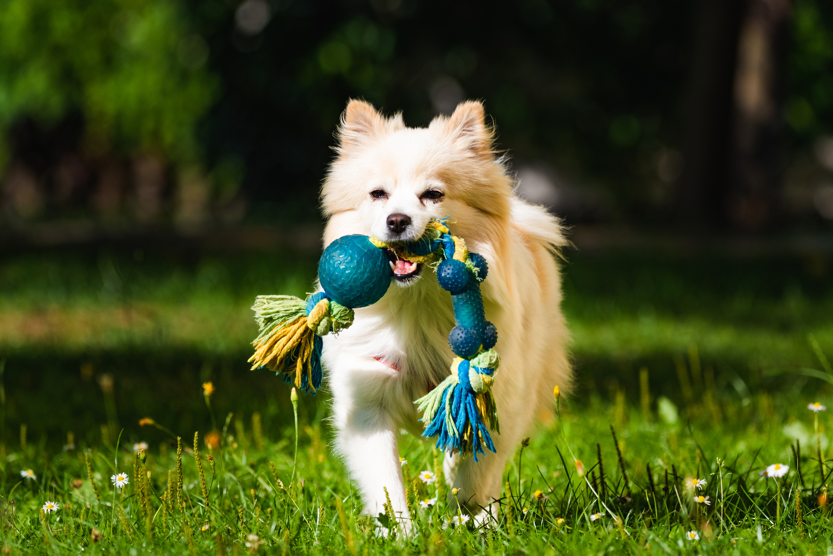

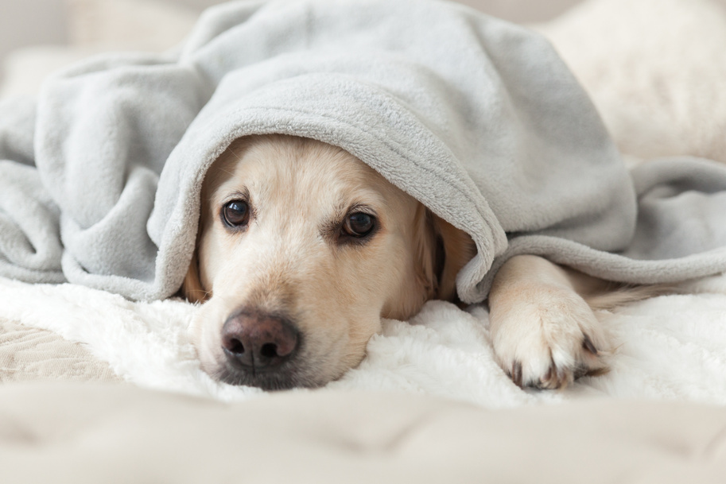
PetClicks offers a social media platform for a fun-filled experience with your pets, all while meeting their needs conveniently in one place.

Slide 3




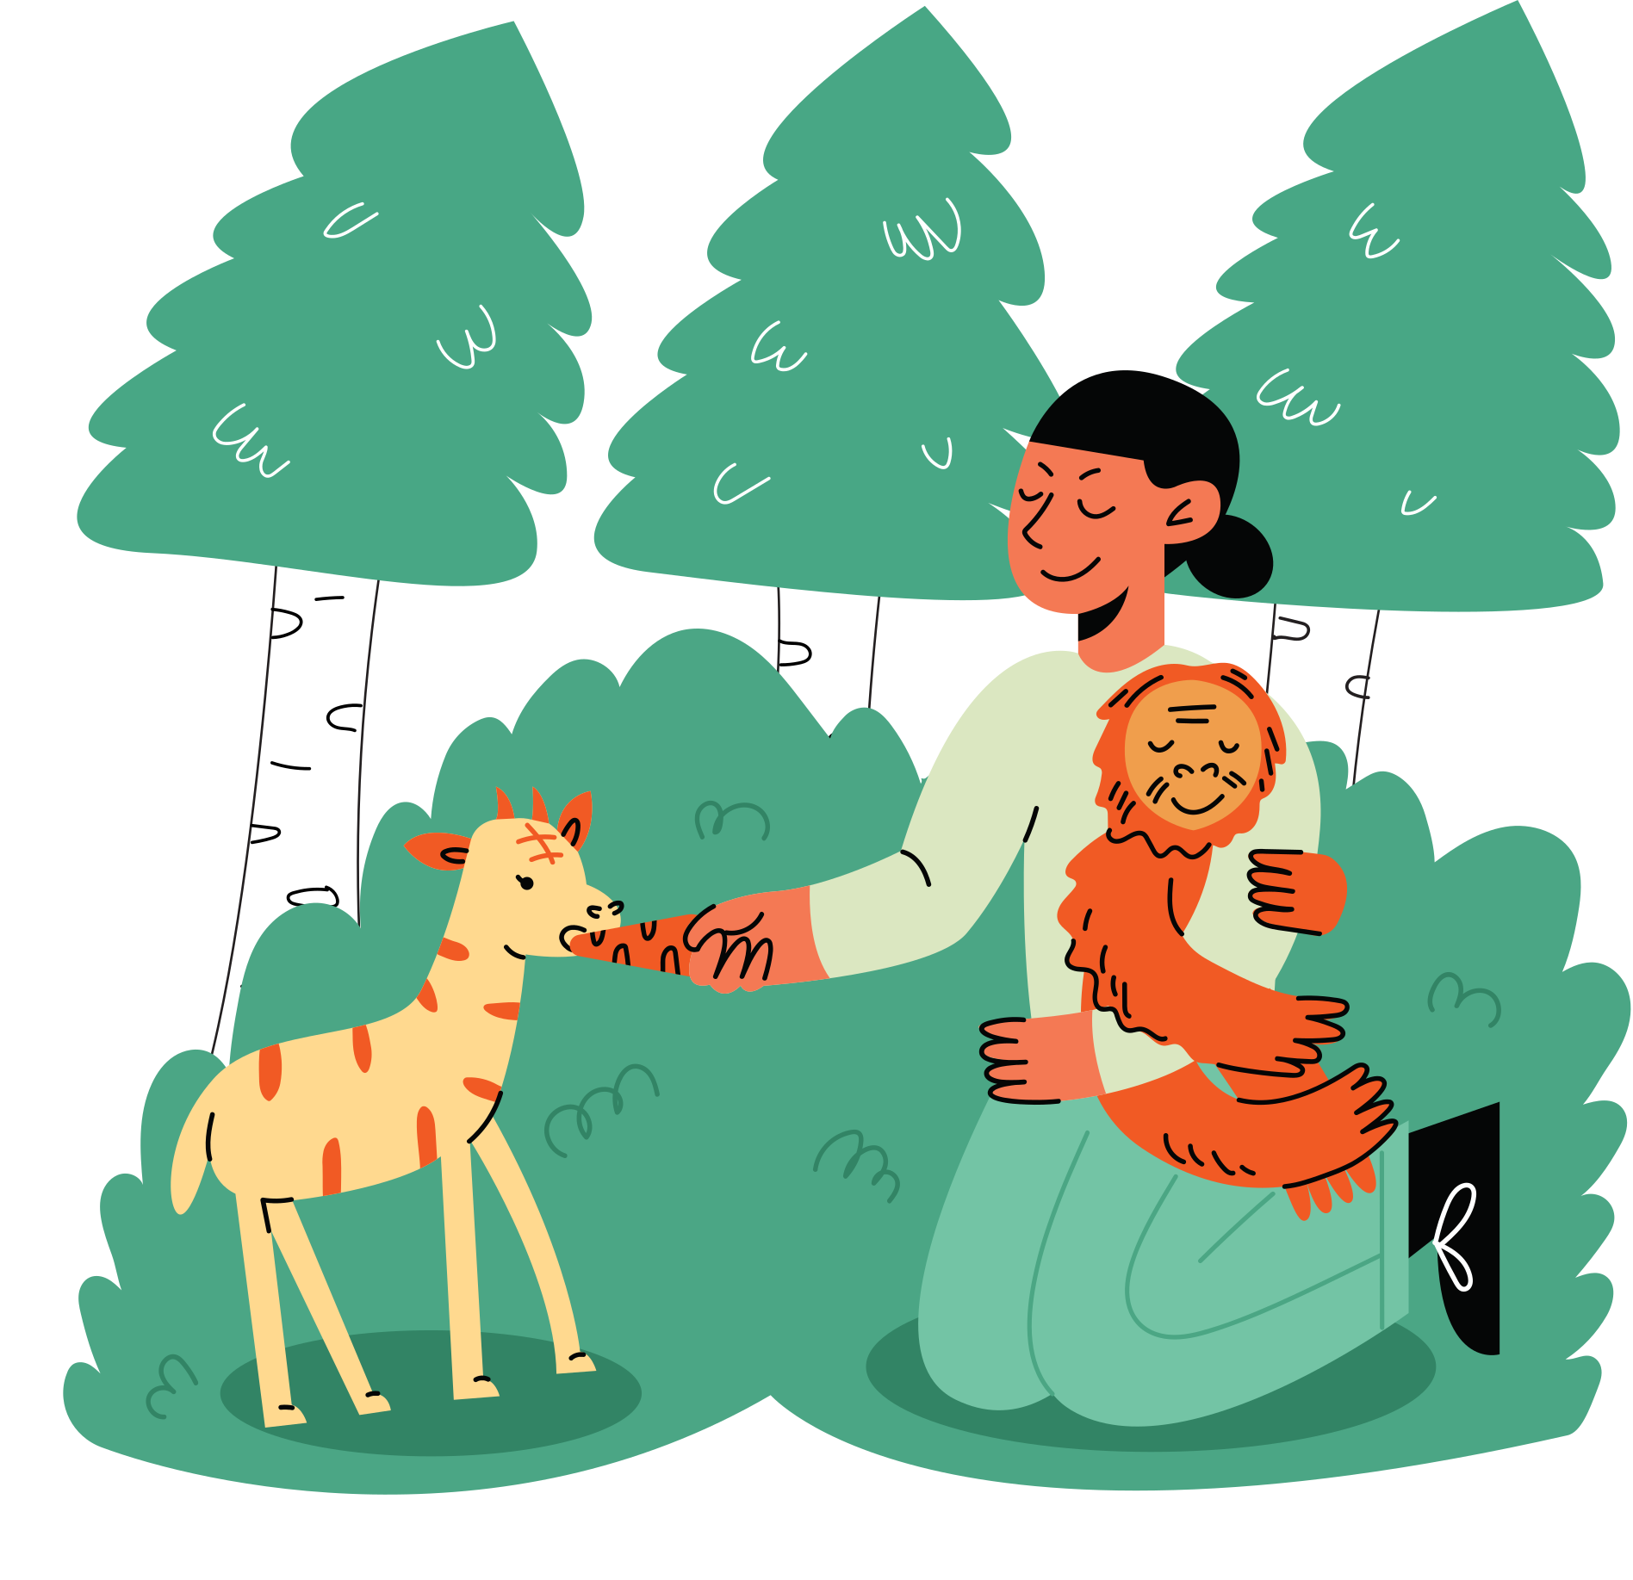


BACKGROUND FOR THE IDEA...
WHAT WE‘VE OBSERVED....
Huge market for pet
products
So many veterinary
services
Big audiance for animals in
social media already
So...
Huge audiance for animal
documentaries
Large comunity of animall
& nature lovers

Slide 4

BACKGROUND FOR THE IDEA... (CNTD.)
So...
We conceived the idea of consolidating all these features into one place to facilitate ease for all our users.
For that,
we've chosen a unique approach, which is a social media platform dedicated to animals.

Slide 5
Implementation...

Slide 6

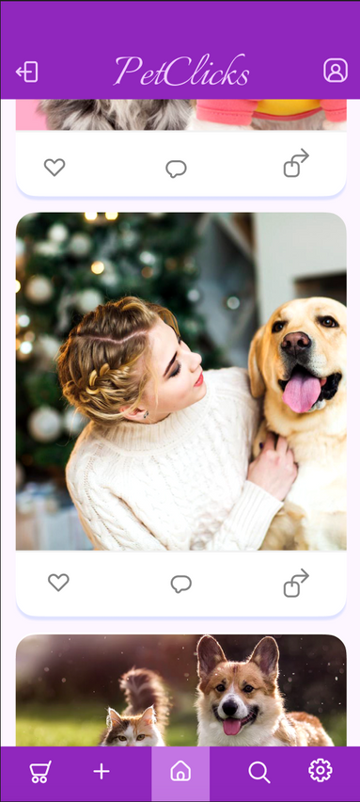
MAIN FEATURES
We are introducing our social media platform for users, where you can have fun by sharing moments with your most beloved pets and reacting to others, similar to most other social media platforms.
Additionally, we aim to provide users with moderately rich photo and video editing features within the app, like on TikTok and Instagram."

Slide 7
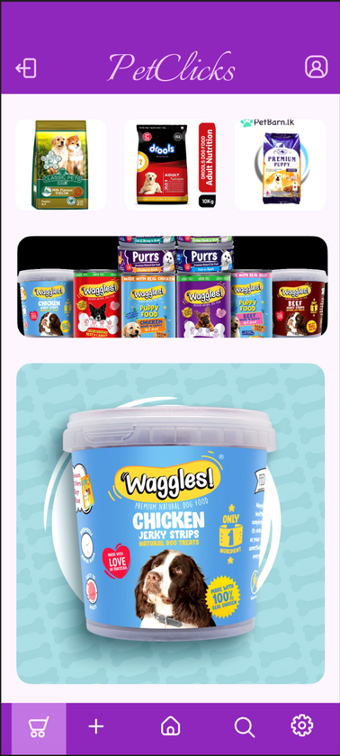
MAIN FEATURES
We are introducing our store, which is a buying and selling platform for pet products. Pet owners can browse and order various pet products through our app, such as animal food.
Sellers can register for our app via seller accounts to sell and advertise their products."

Slide 8
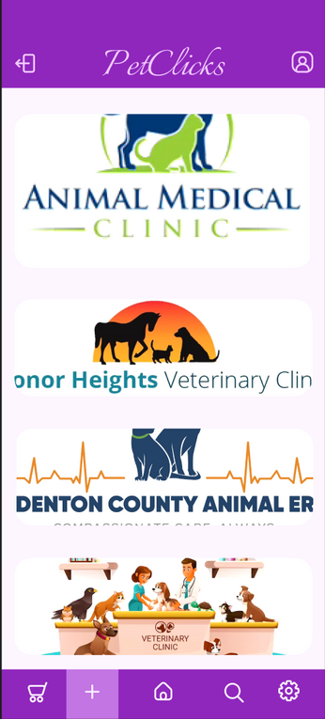
MAIN FEATURES
We are introducing our channeling service after observing the abundance of veterinary services and animal clinics without a proper appointment system, unlike ordinary human clinics.
We aim to facilitate pet owners with a channeling service for animal clinics through our app, recommending the nearest clinical services for their convenience.

Slide 9






ESSENTIAL REQUIRMENTS IN EARLY DEVELOPMENT PHASES
A framework like flutter
A Cloud service for deploy
Music for video editor
A backend server & database

Slide 10
MORE ON TECH....
As our ultimate goal for this project revolves around environmental and animal friendliness, we must rigorously avoid inappropriate content, such as hate speech and content featuring animal cruelty. To achieve this, we plan to implement tighter inappropriate content detection systems.
Additionally, we are planning to incorporate a robust recommendation system within our app, suggesting the most reliable products for animal owners.
Given that our mobile app serves as a social media platform, we recognize the importance of developing an enchanting and visually captivating frontend with an intensely user-friendly interface.

Slide 11
Business Plan
Details...

Slide 12


Step 1
At first, we introduce this as a social media platform where users can edit their photos and videos using PetClicks editors and incorporate PetClicks music before uploading, reacting, commenting, and sharing.
Step 2
Enable users to buy and sell pet products via PetClicks by allowing them to create separate selling accounts and regular accounts.
We facilitate pet owners with regular accounts to access online veterinary services and purchase various pet products, including food and medicine, through PetClicks.
Sellers with dedicated accounts can advertise their products or services on PetClicks, and we benefit from a commission earned through advertising.

Slide 13

Step 3
We will provide a platform for users to upload animal and nature-related documentaries, vlogs, and blogs for subscribers to watch, read, be entertained, and gain knowledge. We plan to charge a subscription fee from users with premium access.
Step 4
Finally, we hope to begin producing our own food products, creating original documentaries and vlogs, offering merchandise such as clothing, cups, artifacts, etc., and initiating a transport service to deliver ordered products to customers ordered through the app.

Slide 14
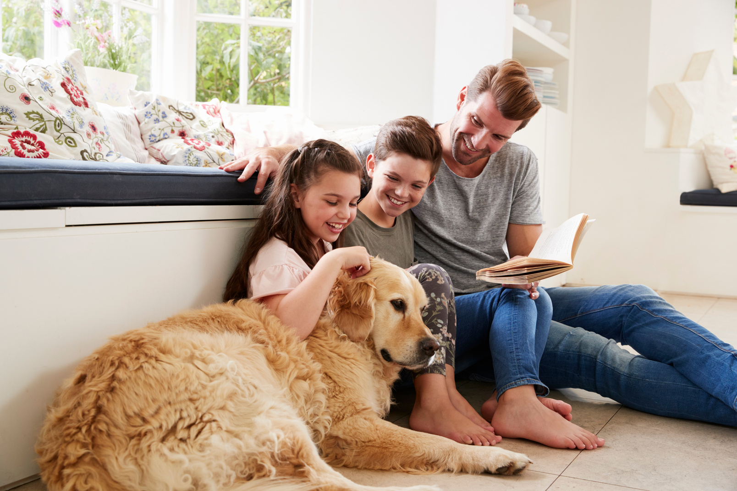
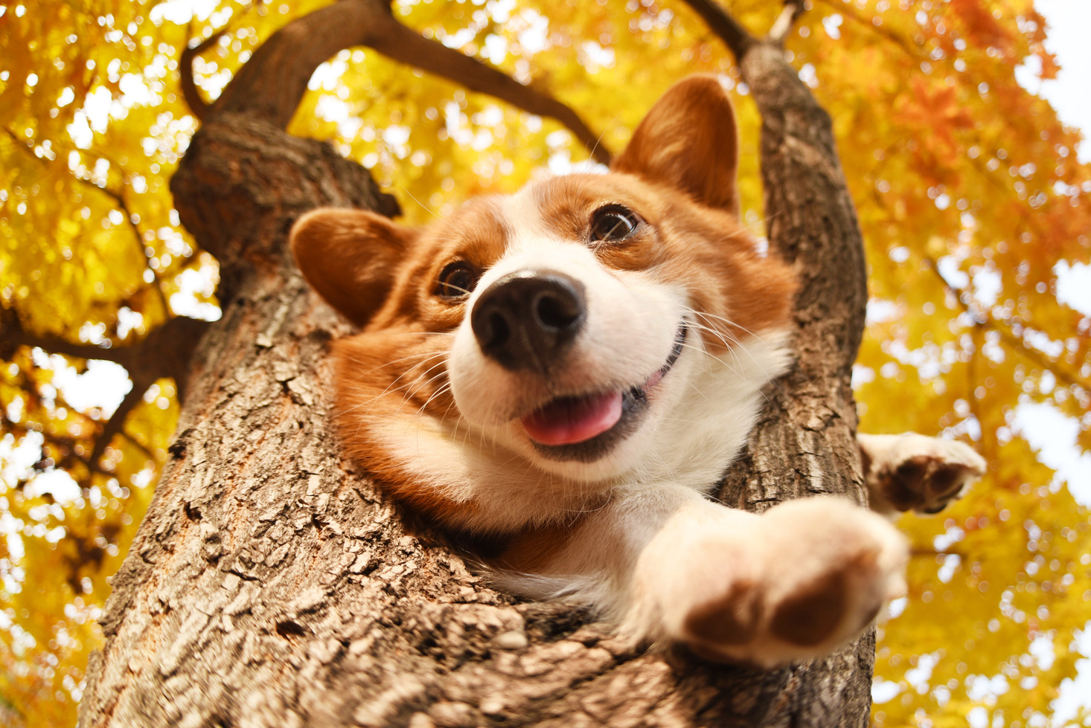
WHY A SOCIAL MEDIA APP ???
With the widespread use of social media for entertainment, marketing, and various purposes these days, we believe that our approach is quite attractive and unique compared to just a traditional buying and selling app or a booking service or ...

Slide 15




Product sellers (Advertisement commisions, Order commisions)
Vets and Animal Hospitals (Advertisement commisions, Booking commisions)
Pet Owners (Subcriptions for premium features)
TARGET MARKET

Slide 16



COMPETITORS
Other Social Media platforms.
But there is no other social media platform fully dedicated to animals.
So
there are NO any direct copetitors for us at all!
Pet product sellers, wets that have their own online platforms.
But there is no platform where everything together.

Slide 17

Competitive Advantages

Slide 18



This is a completely different type of social media app that has never existed before, providing a unique experience for both social media users and influencers.
We are introducing special effects and music specifically designed to enhance your pets' videos and photos with our editors.
Finding anything you want is much easier through this app than searching across thousands of websites because PetClicks classifies all products and services in one app, providing easy access for you.

Slide 19

Competitor
Approach

Slide 20



We are always connected with our customers.
We consistently provide new updates to our app, add more clinical services/products every day, and continuously introduce new materials and features for our subscribed users to maintain their perpetual excitement.
We plan to conduct events such as dog shows and animal awareness programs. Additionally, we aim to collaborate with similar event organizers, providing them with the opportunity to stream through our app and be watched by our subscribers, thereby enhancing the reach and popularity of our application.

Slide 21


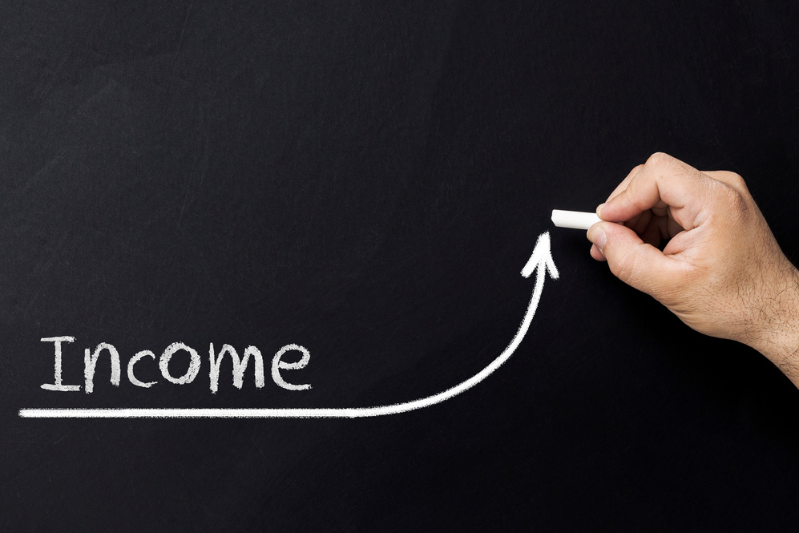


INCOME FLOWING STREAMS
Subcription fees from our premium content users.
Income from transport service after we started our own transport service for delivering products.
Commisios from advertising.
Commisios from orders through our app.

Slide 22
Long Term Plan...

Slide 23
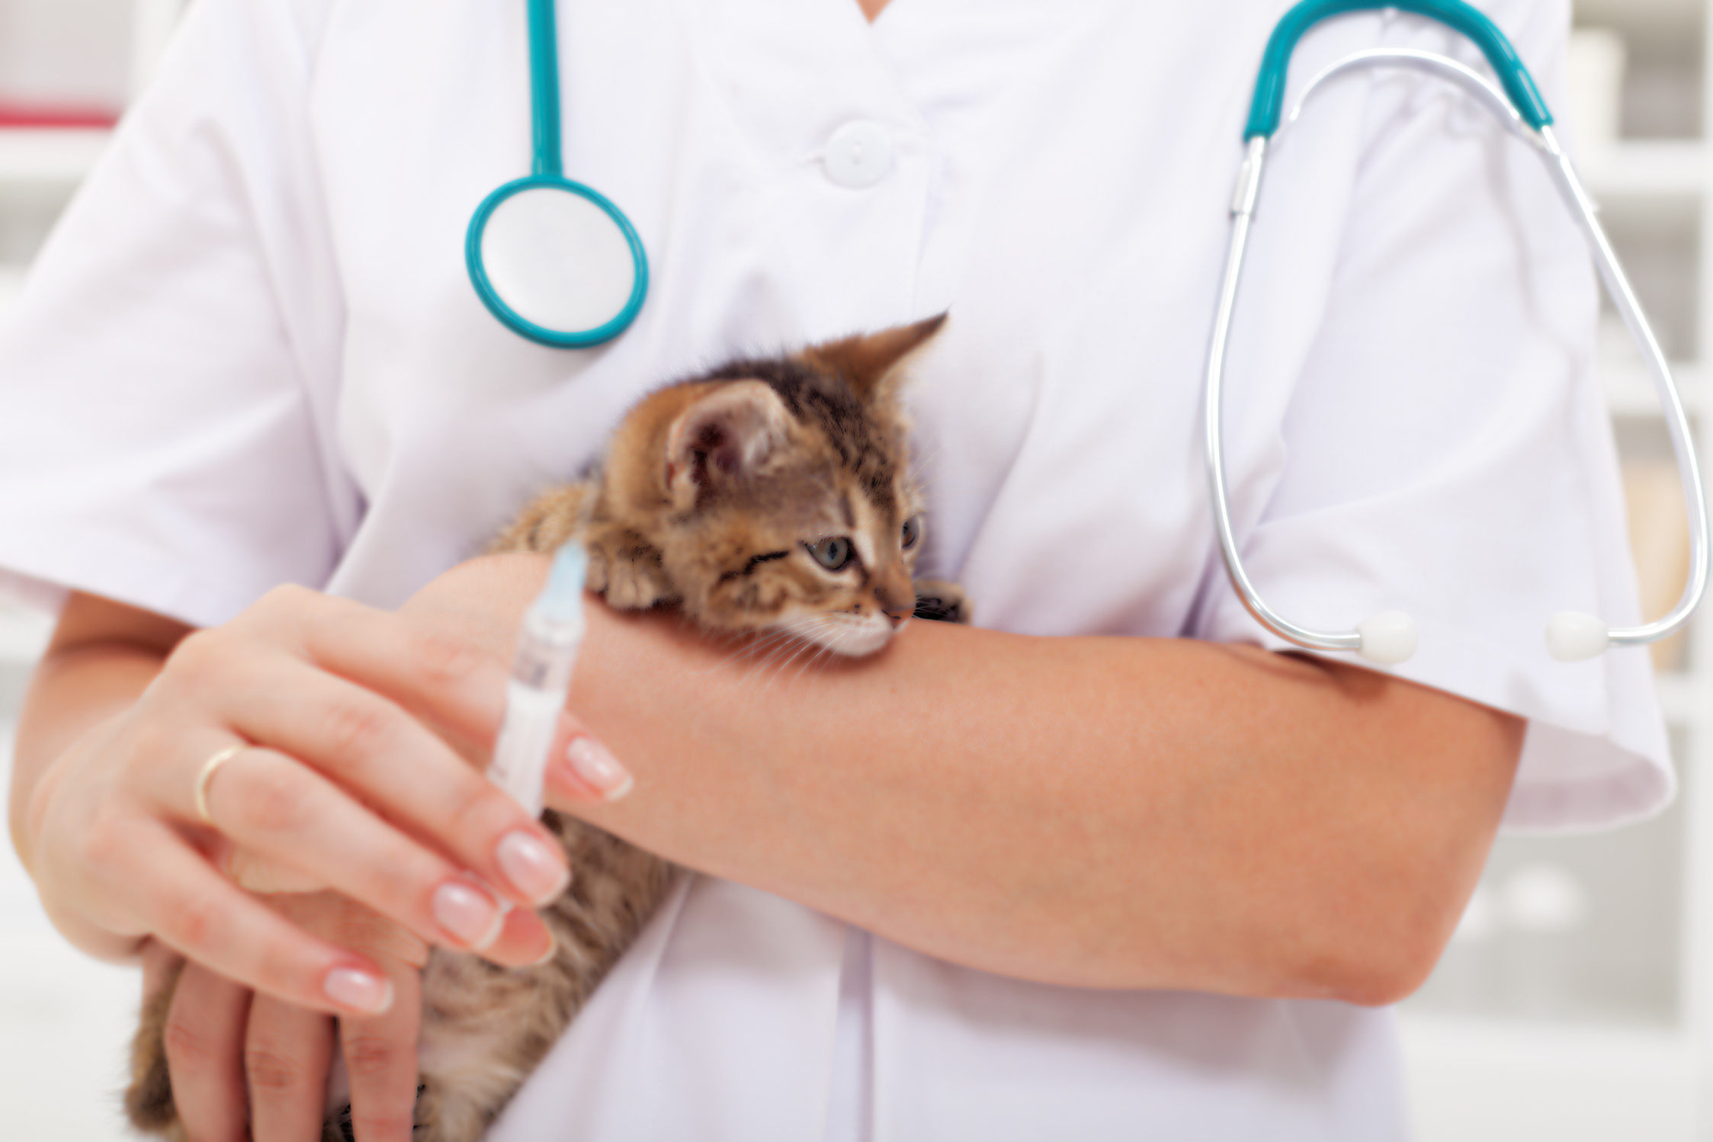
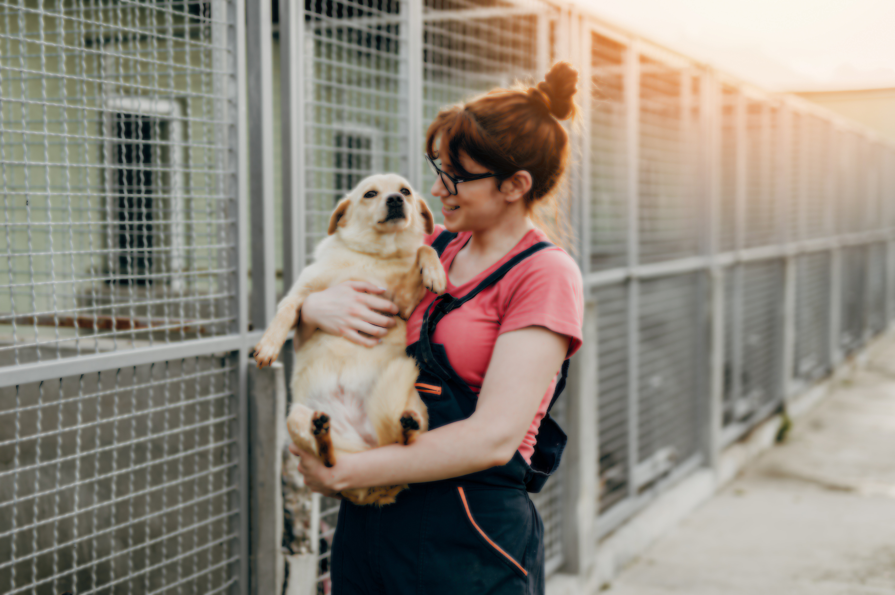

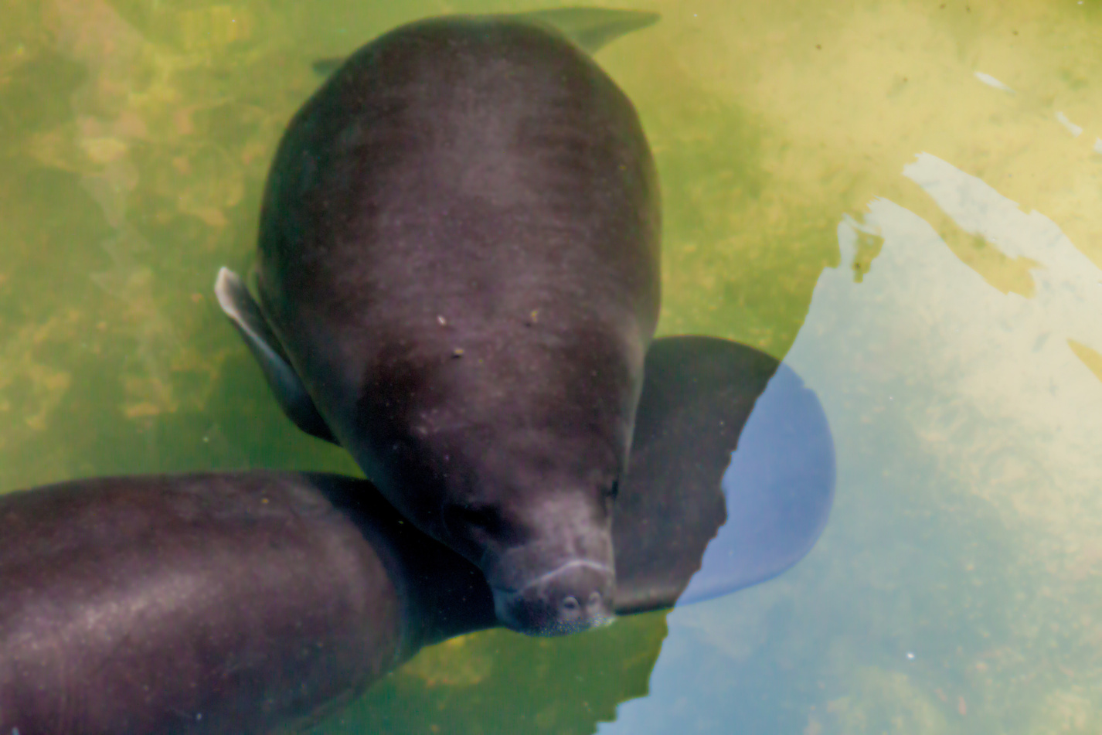
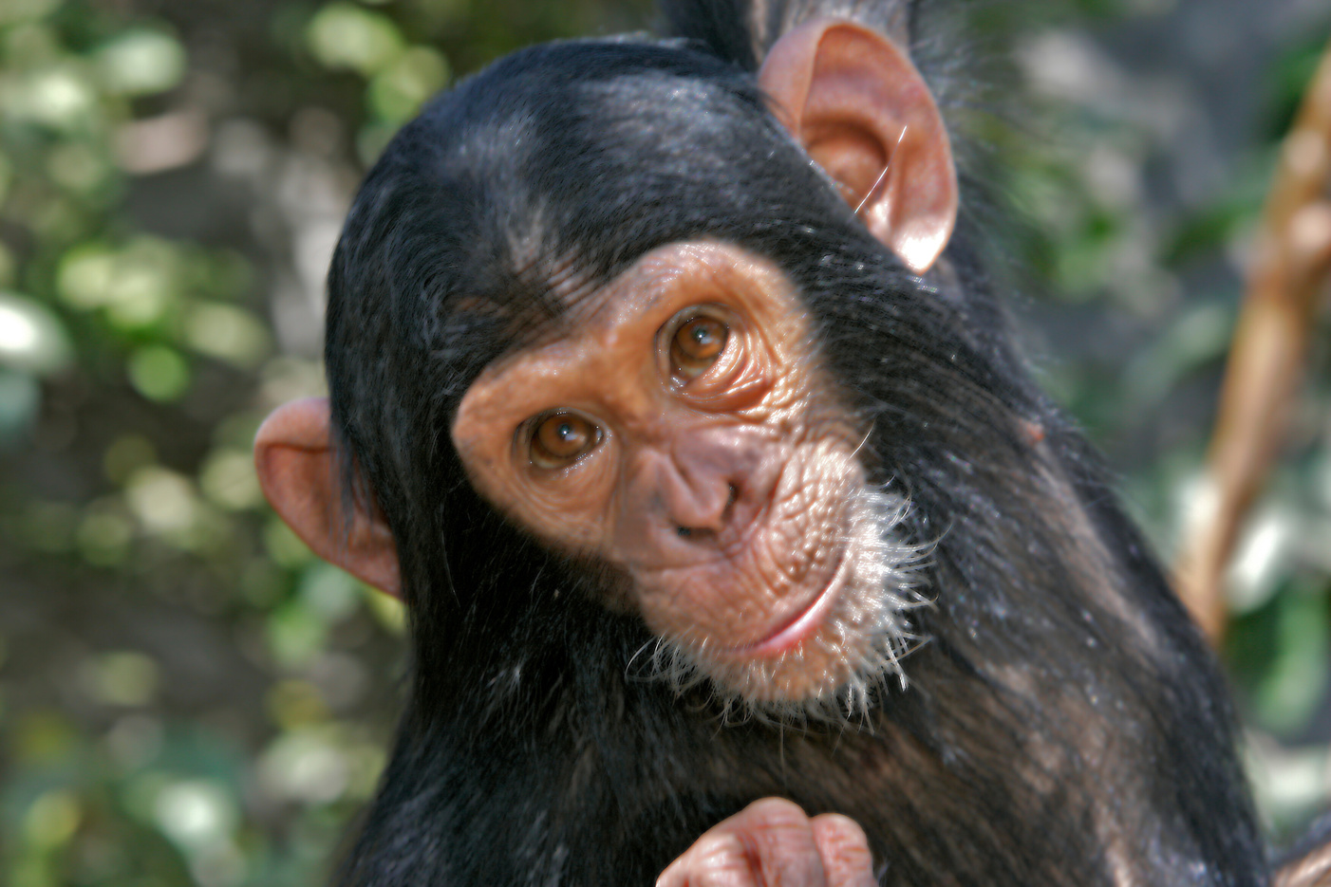
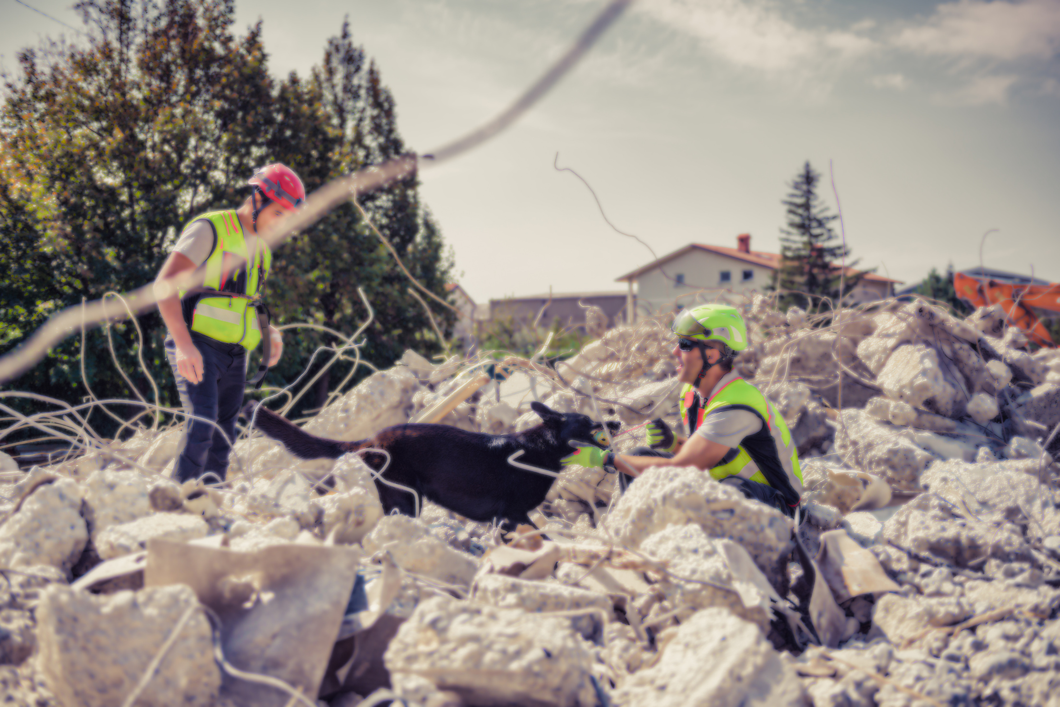
Animal Rescue programmes
Long term plan of PetClicks is to ensure animal safety all around the world, prevent animal cruelty and protect animal rights.
Programmes to protect endangered species
Raise voice against environmental destruction
Advancing the revenue avenues furthermore.

Slide 24

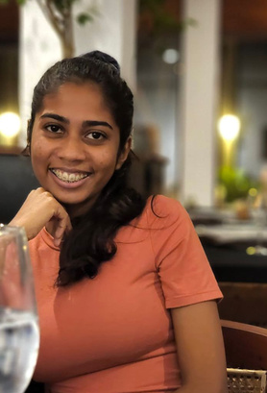
Apps
TEAM ONEZERO
Preserving Animal life, Powering Prosperity.
ANGAMMANA A. N. K.
YASHAN W. V.
University of Peradeniya
University of Moratuwa

